Slide 1


Reporting service (RS)

Slide 2
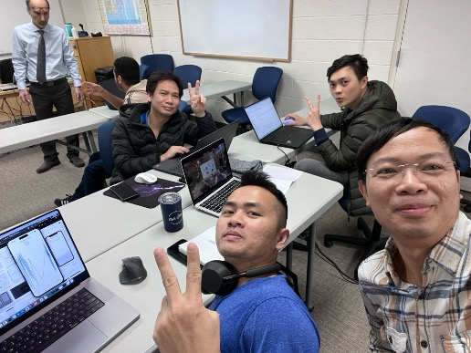
Team: PRIUS
Reporting service
Dinh Thang Nguyen
Ha Vu Duy Nguyen
Huy Toan Nguyen
Van Ty Pham

Slide 3

Agenda
Overview about RS
Team roles
Architecture
Deployment diagram & CI/CD
Technology stack
Screenshots & demo

Slide 4
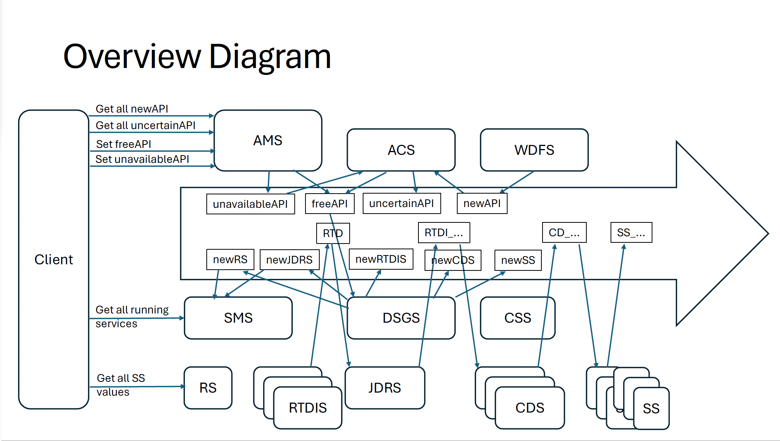
What we do in whole picture
iOS
SS_..
Web app
RS

Slide 5
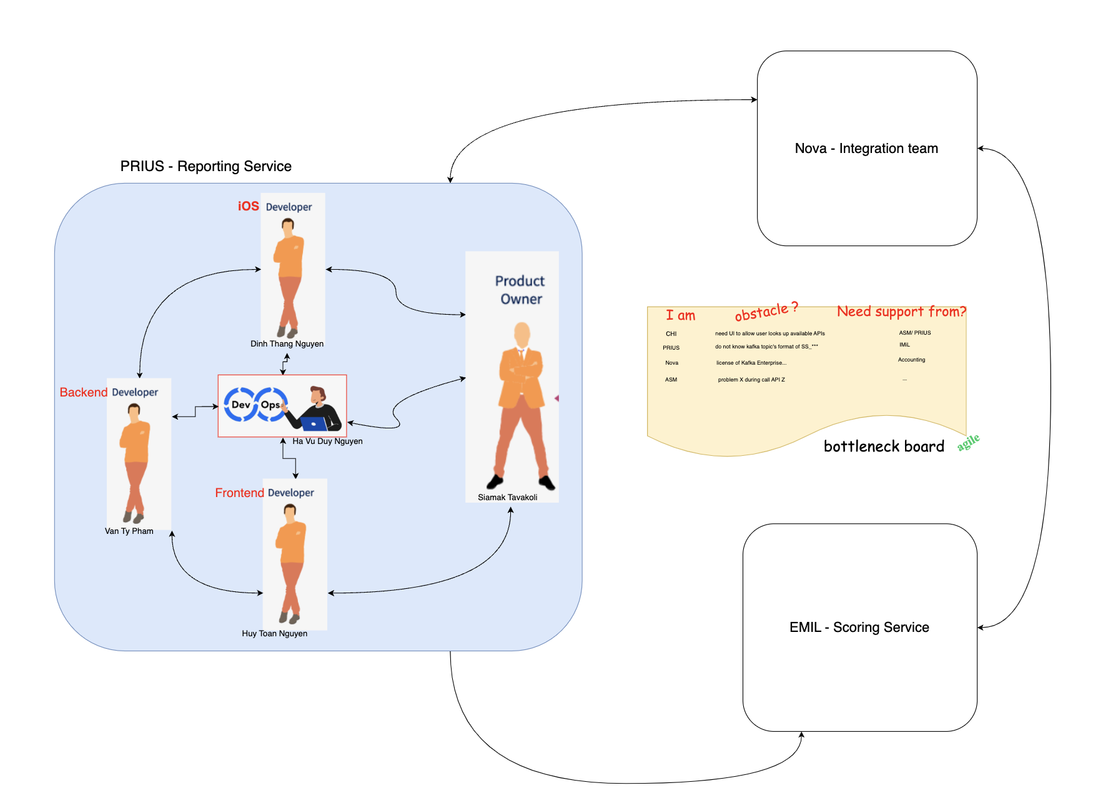
Team roles

Slide 6

Reporting service
Subscribes to the topic “SS_...” – scoring service
Serves the Client : Provides all values published by SS in the shape of a table - chart
Informs the user of all current Sensitivity Index values
Allows export of the listed information in CSV formatted file

Slide 7
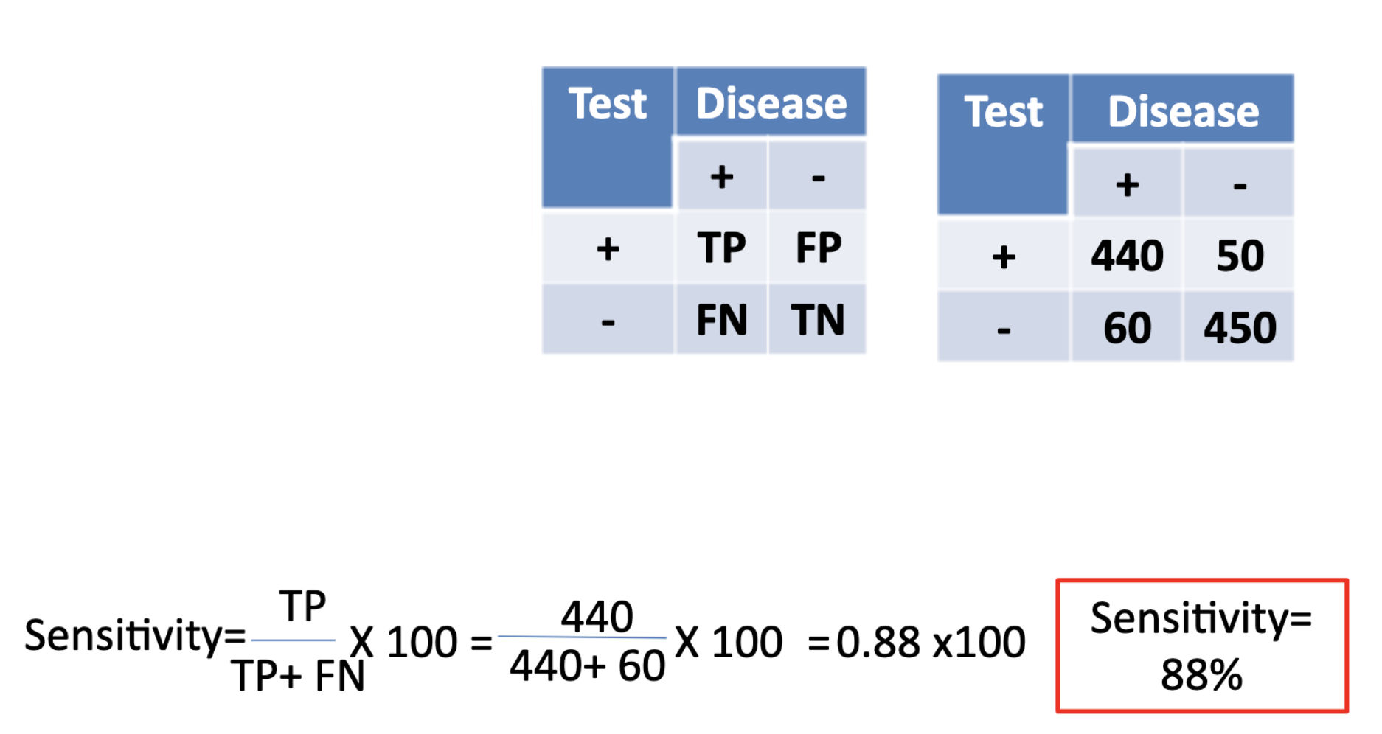
What is sensitivity ?

Slide 8
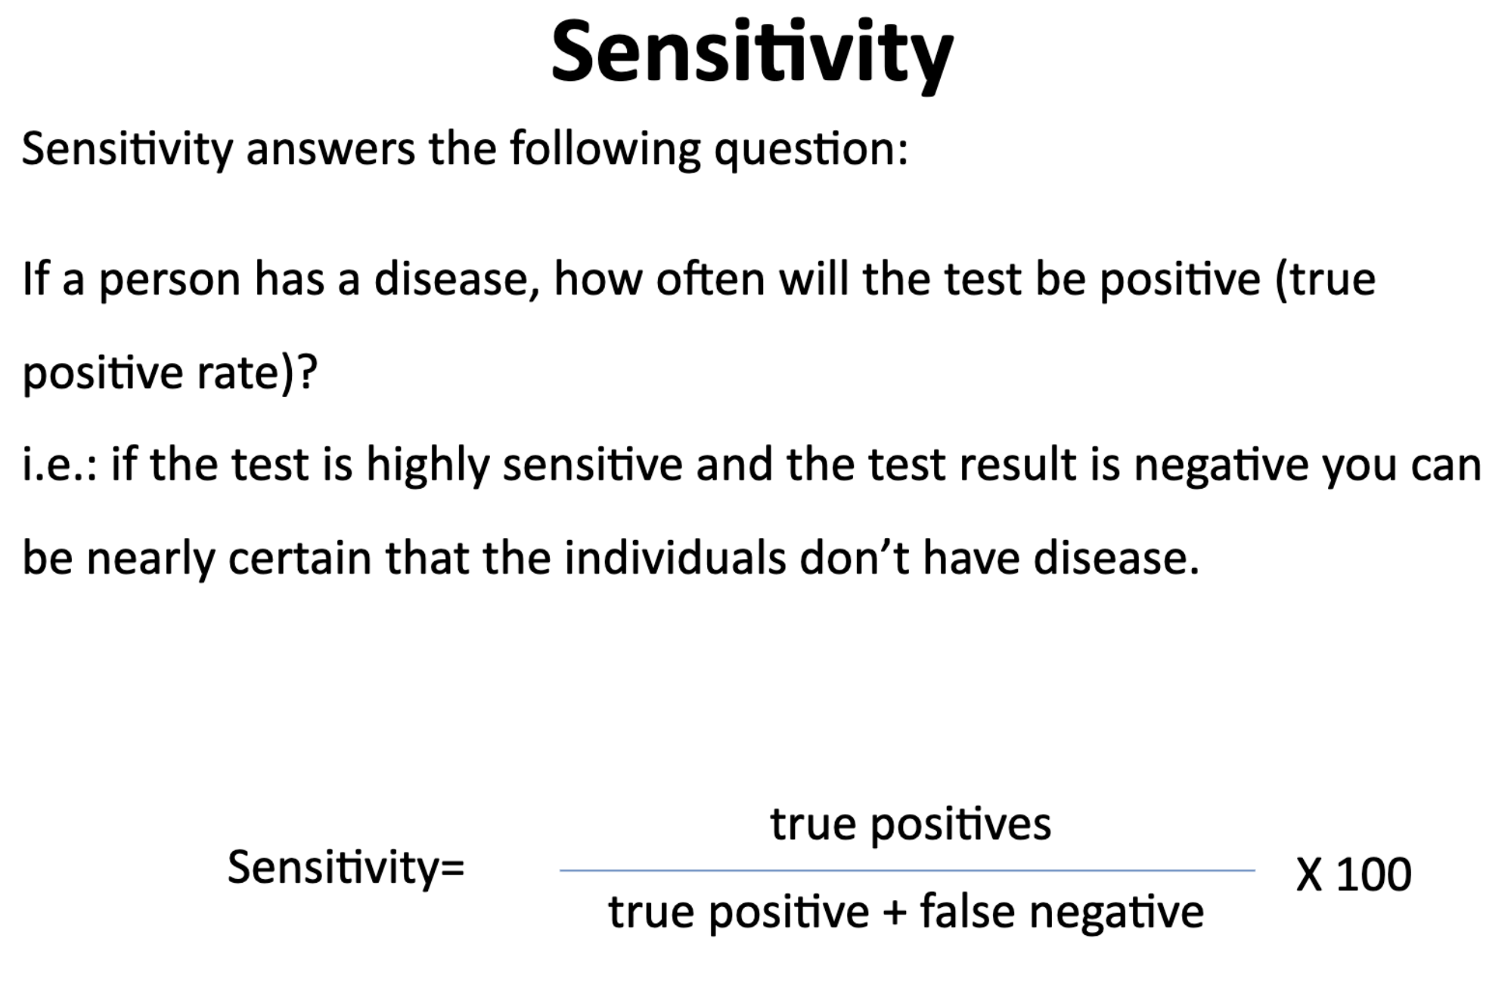
What is sensitivity ?

Slide 9
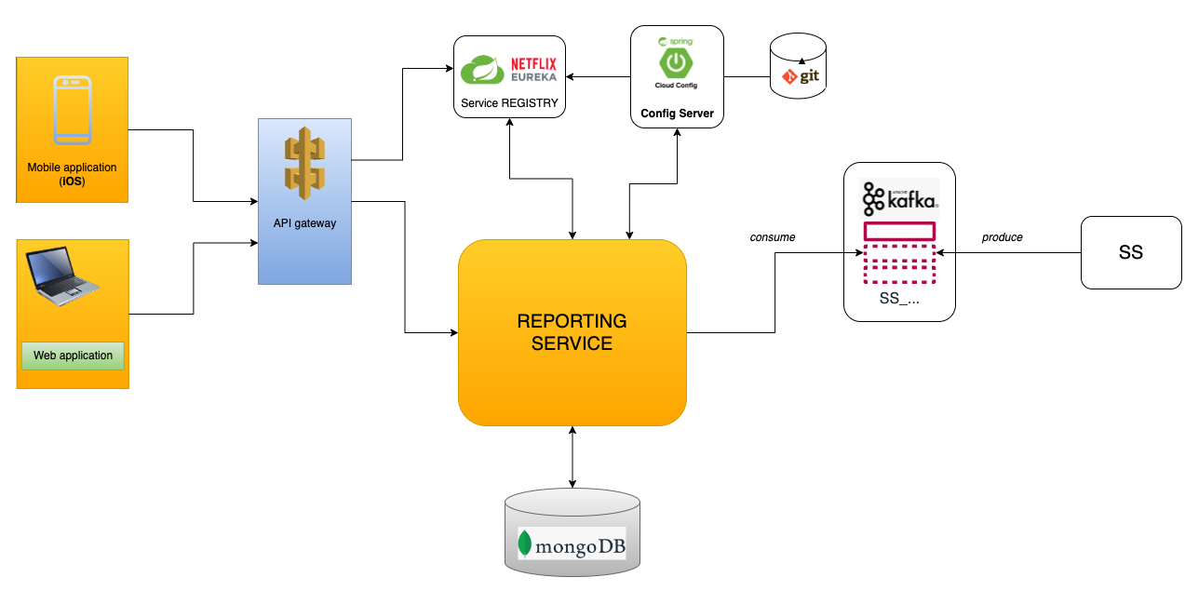
Microservice architecture

Slide 10
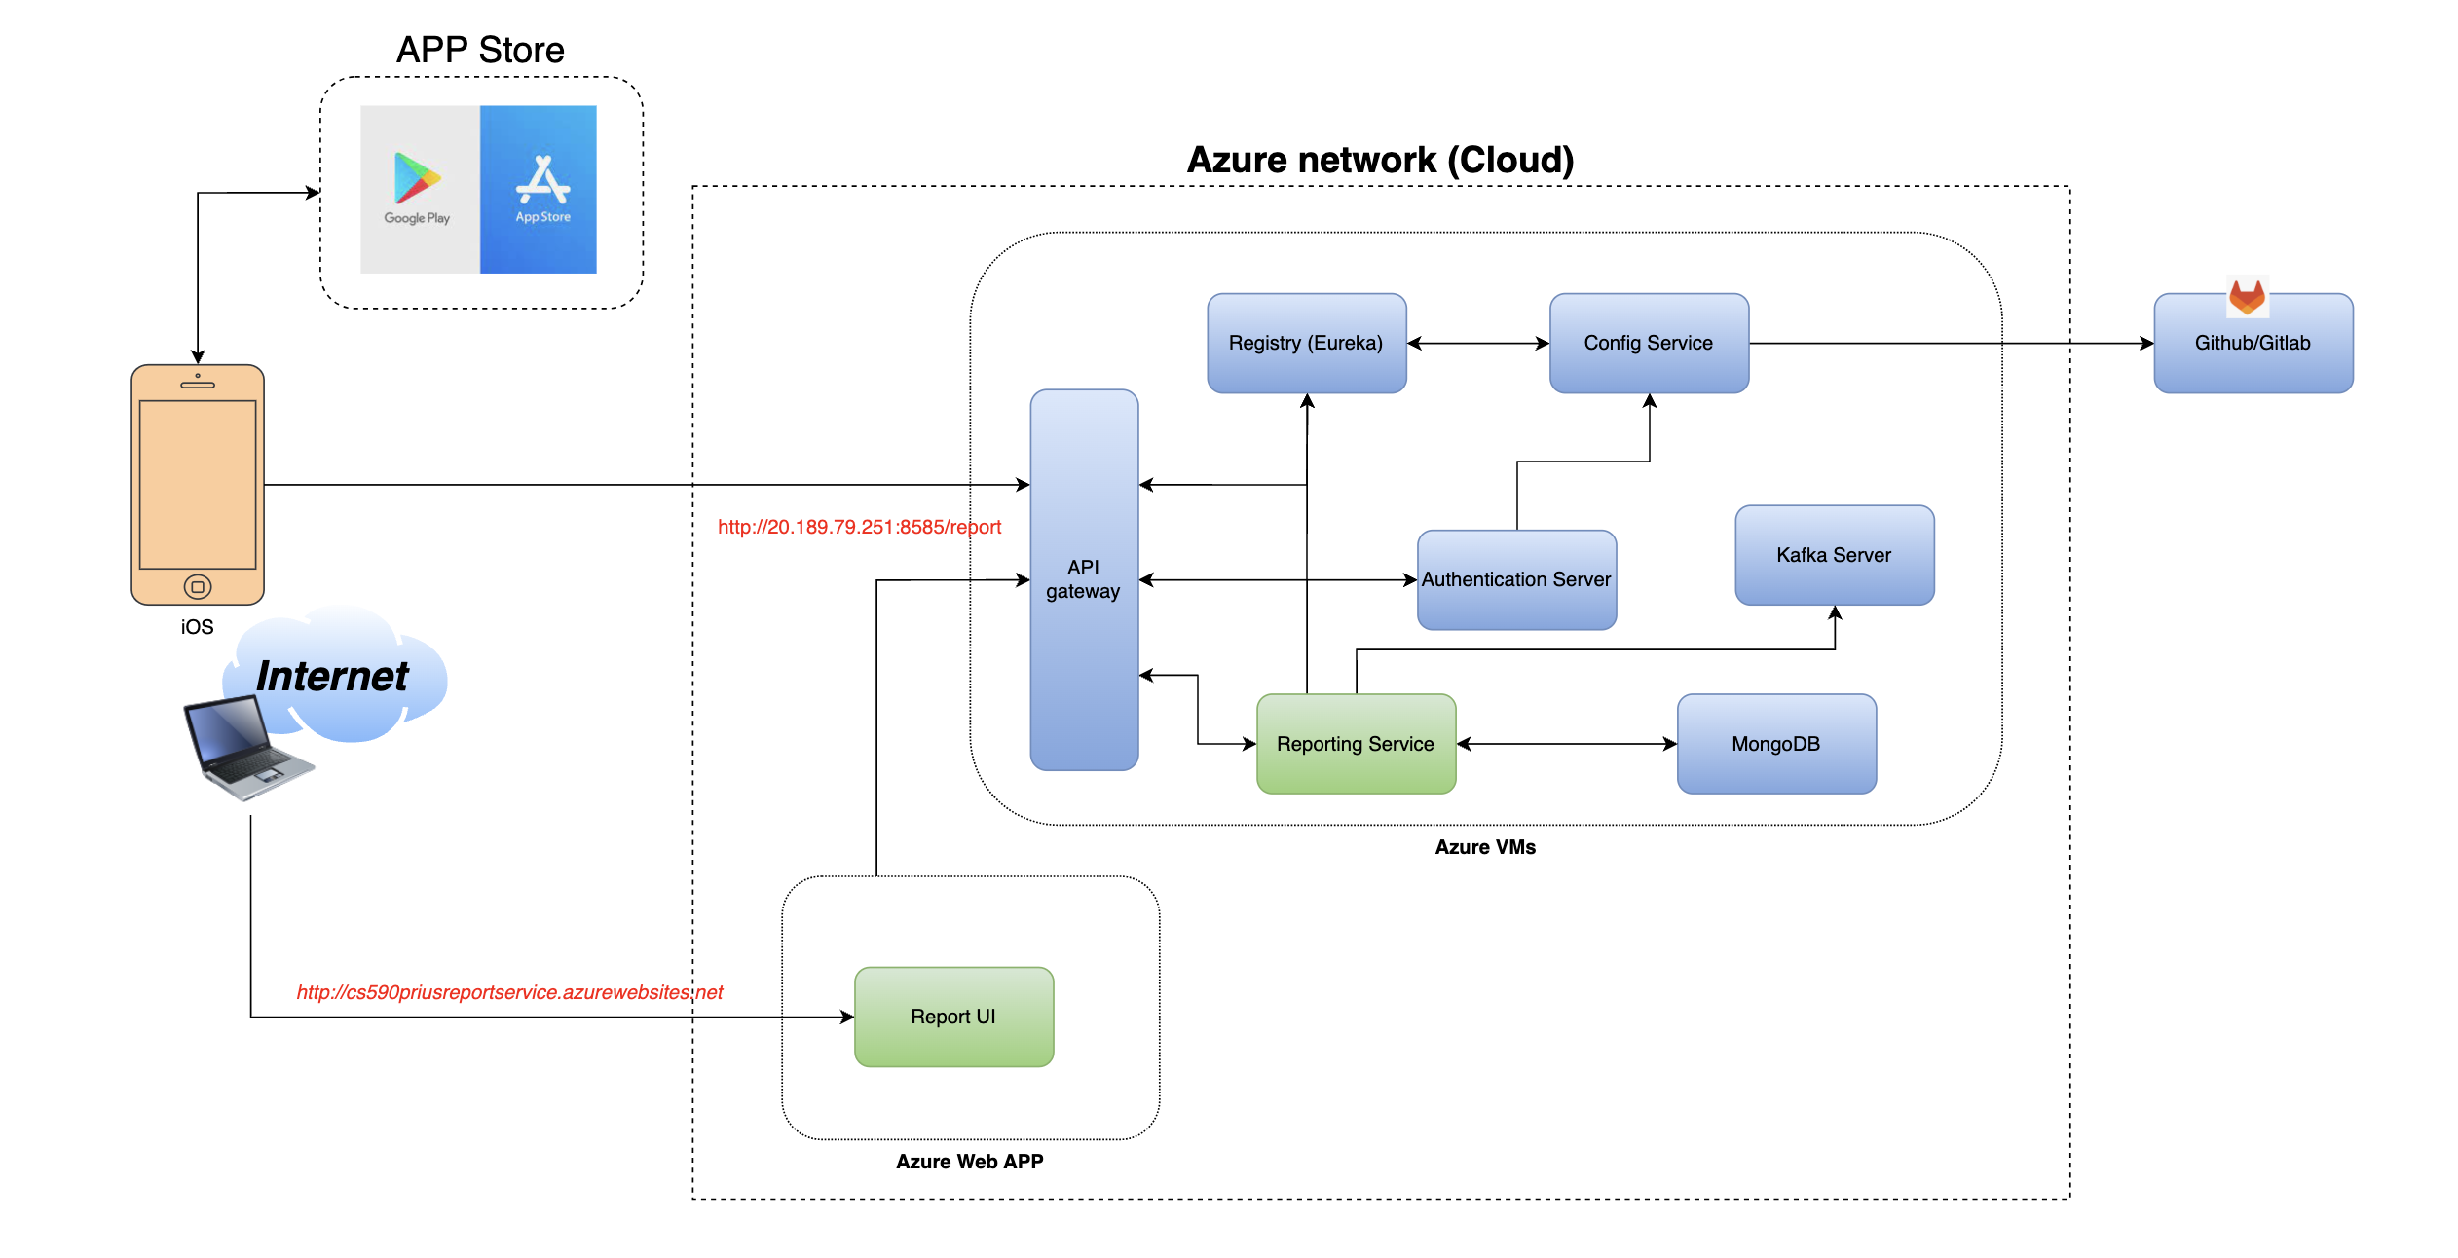
Deployment diagram

Slide 11
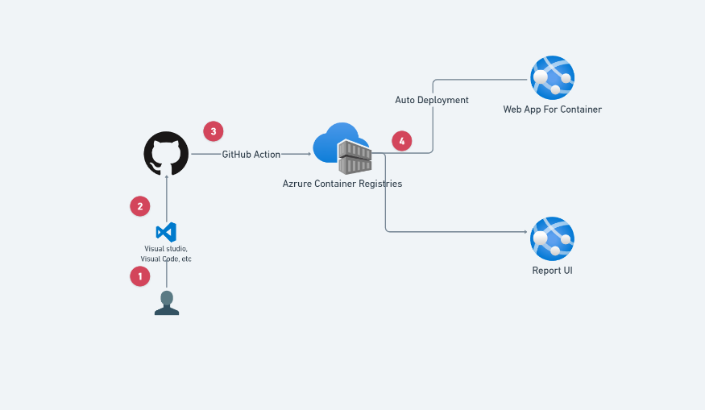
auto ci/cd

Slide 12
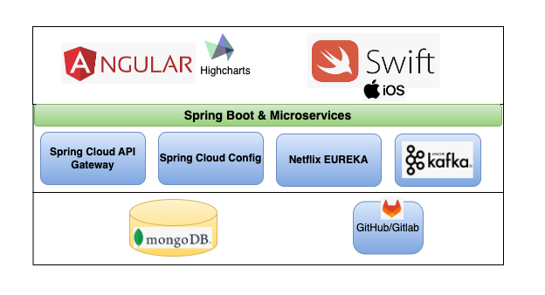
Technology stack

Slide 13

Mobile Tech stack
Combine + swiftui
Ddd
Clean architecture + MVVM
Tools (Xcode + Cocoapods)

Slide 14
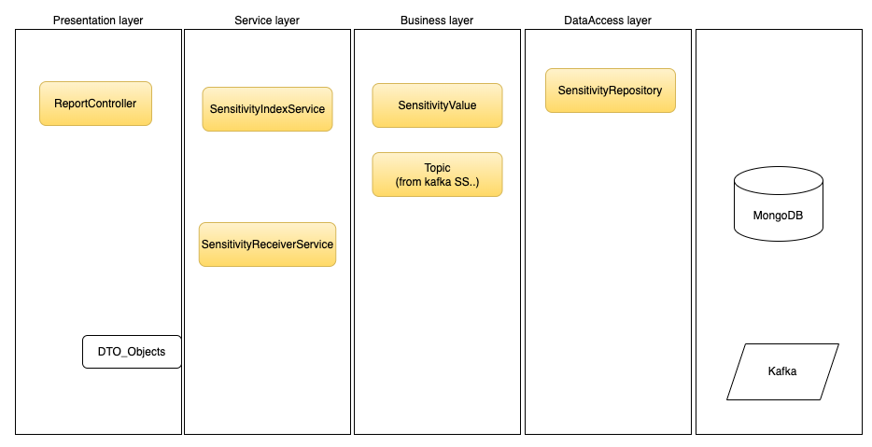
Layers in microservice - RS

Slide 15
screenshots

Slide 16
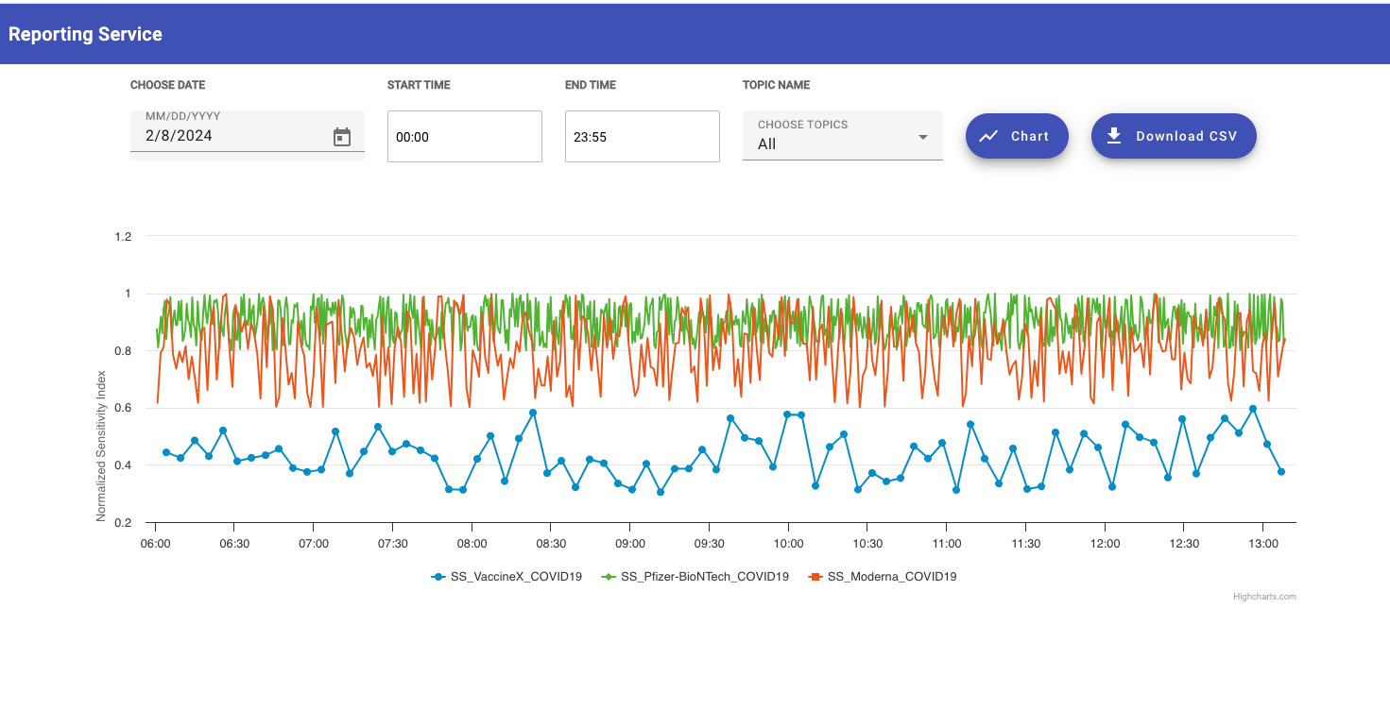
Report ui (web app)

Slide 17
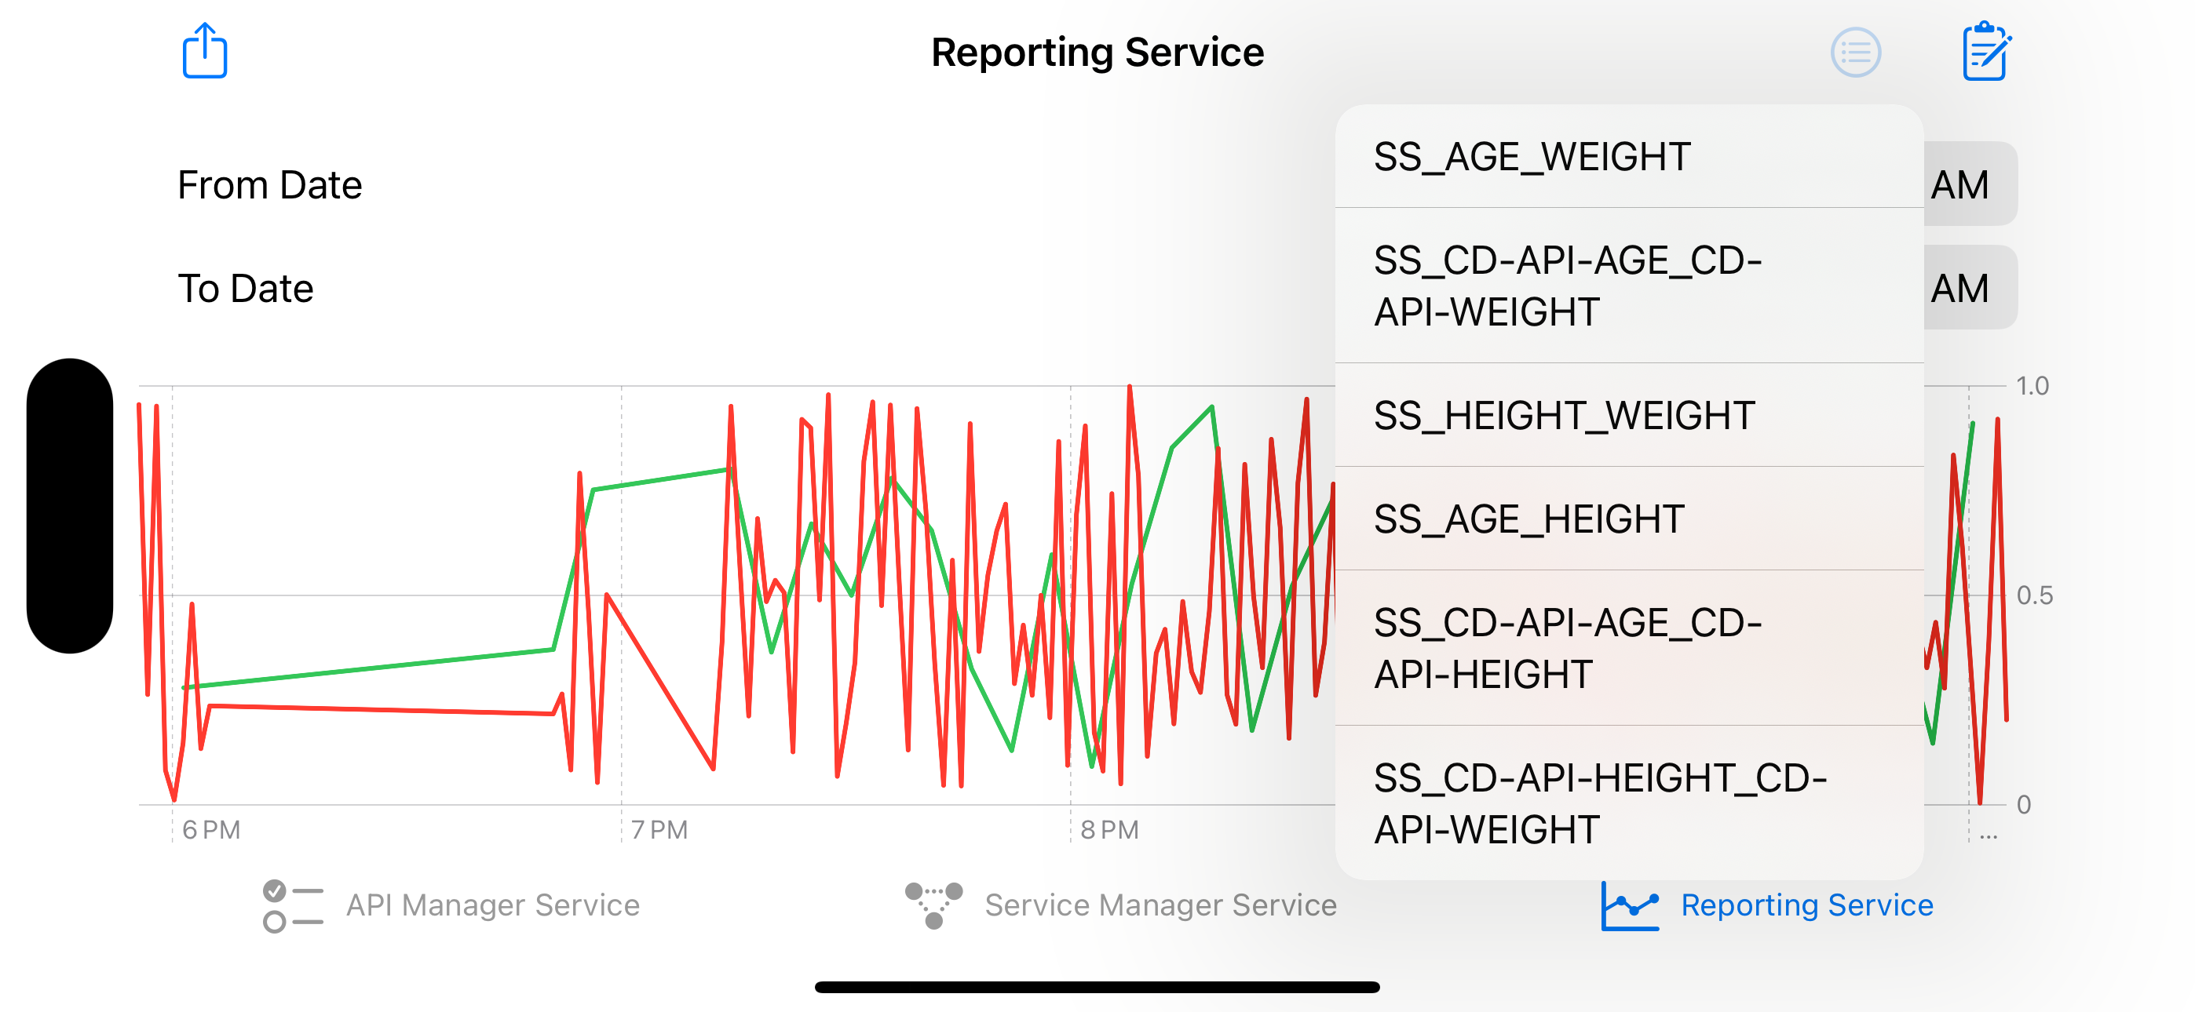
Mobile iOS app

Slide 18
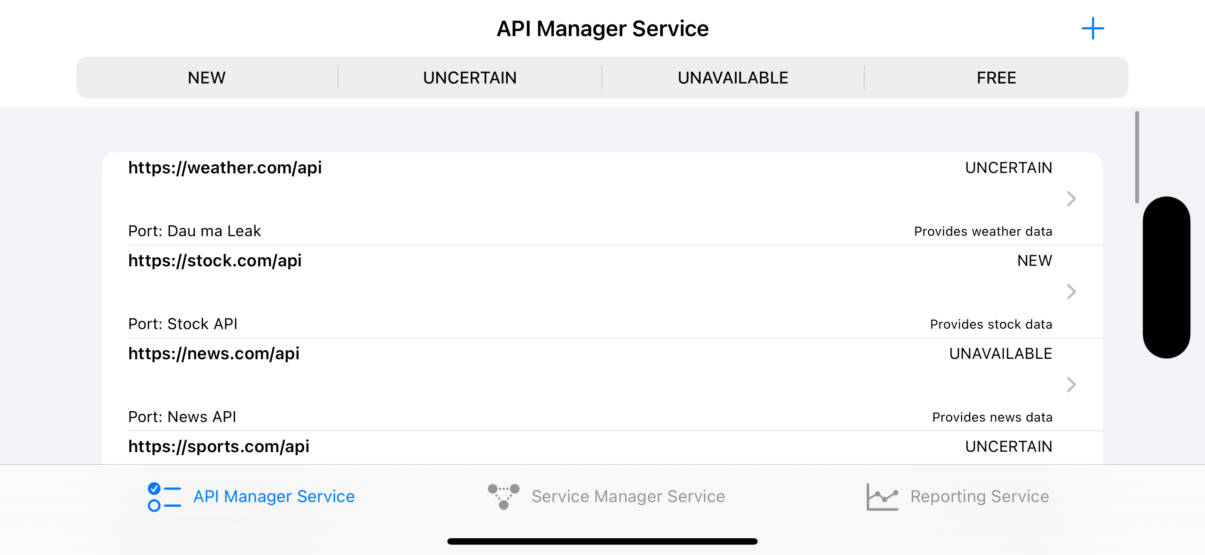
Api management ui

Slide 19
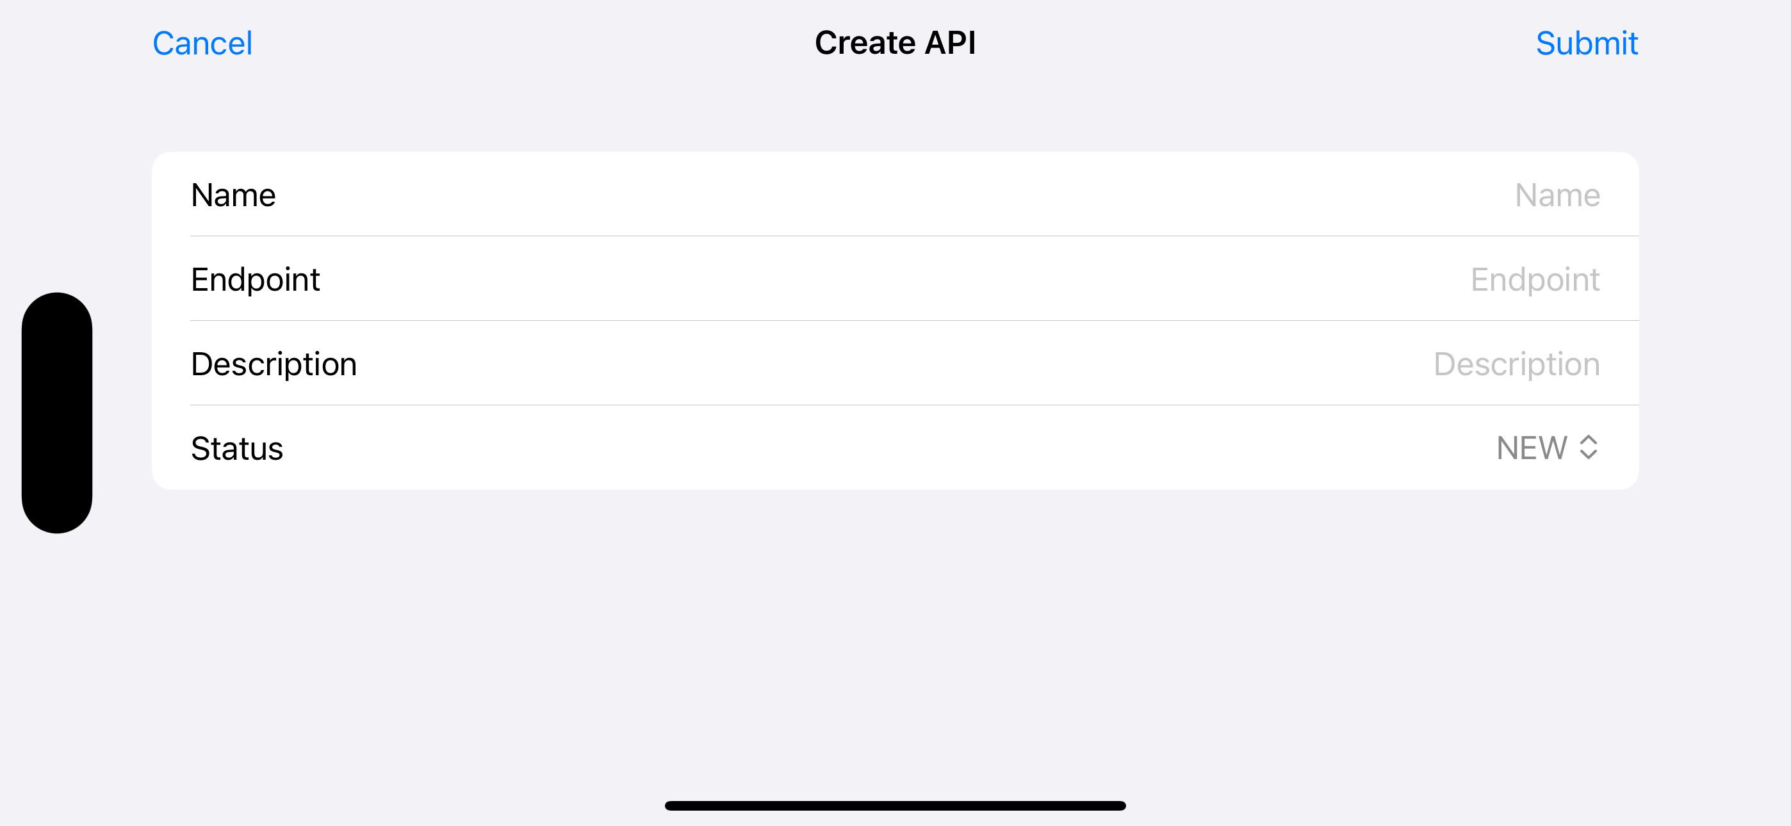
Api management ui

Slide 20
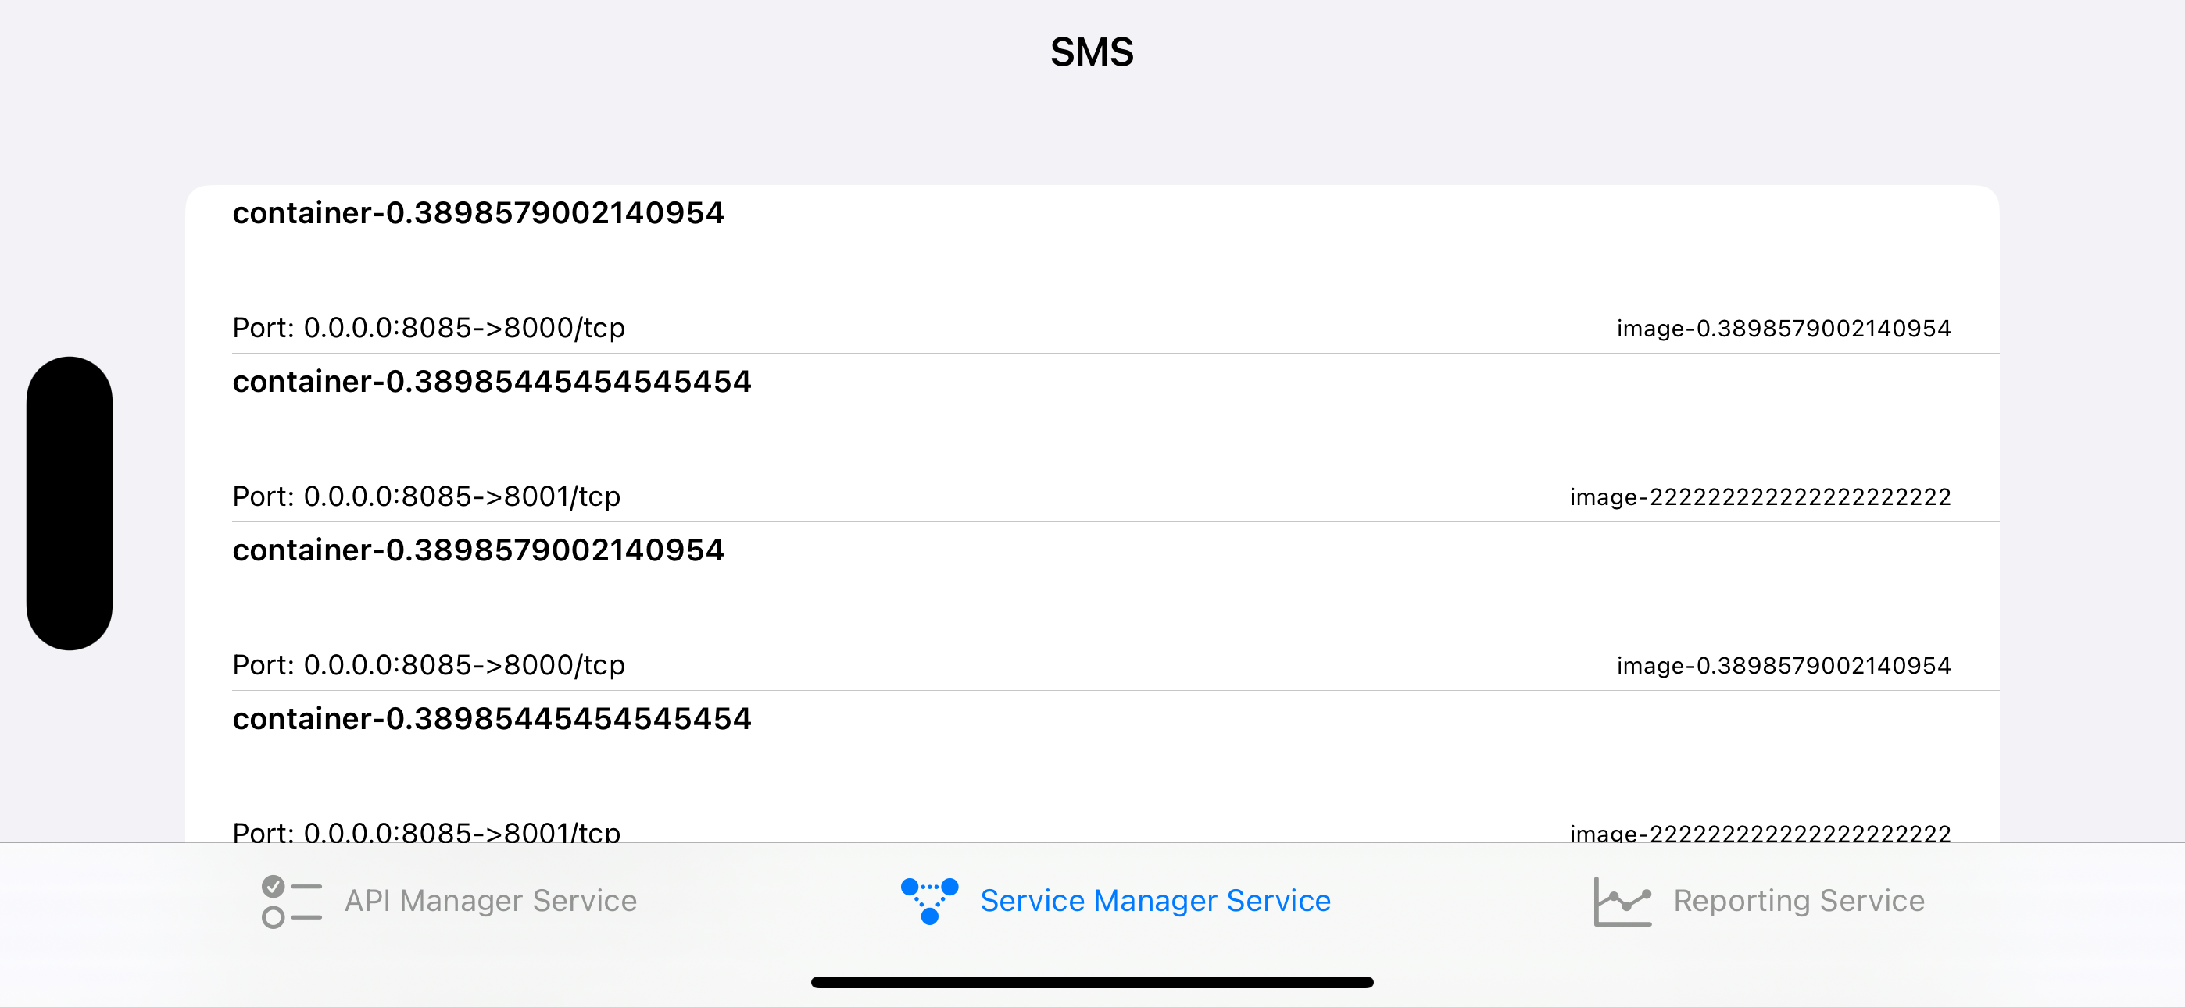
Sms ui

Slide 21

Q&A

Slide 22

Thank you!

